Slide 1
Week 6: Scipy and Sympy
FFT, symbolic calculations - your additional topics!
Recordings [to be posted]
No meeting on 12/018!

Slide 2
Passing arguments to functions
When calling a function in Python, arguments get passed “as an object”
In Python, objects can be mutable or immutable
A mutable object can be changed after it is created, and an immutable object can’t.
Objects of built-in types like (int, float, bool, str, tuple, unicode) are immutable. Objects of built-in types like (list, set, dict) are mutable. Custom classes are generally mutable.
Passing an immutable object is equivalent to passing by value
the function creates a local copy of the input object value, any modifications to its values are within the local scope; changes to object value need to be returned explicitly to change in global scope
Passing a mutable object is equivalent to passing by reference
the function has access to location of input object, any modifications to its values take place at the original memory location; modifications to input object values do not need to be returned

Slide 3
Week 5: Review
OOP practice,discussion of review notebooks
Please attempt two review notebooks: syntax, plotting, send your solutions to krausee@arizona.edu
more on passing arguments by object reference
Recording 12/09
No meeting on 12/11!

Slide 4
Week 4: Python Practice
SciPy, Object Oriented Programming
Please attempt two review notebooks: syntax, plotting, send your solutions to krausee@arizona.edu
Recording from 11/30, 12/02
No meeting on 12/04!

Slide 5
Week 3: Python Practice
Model fitting, merge-sort algorithm
Two review notebooks: syntax, plotting
Recording from 11/23, 11/25
No meeting on 11/27

Slide 6
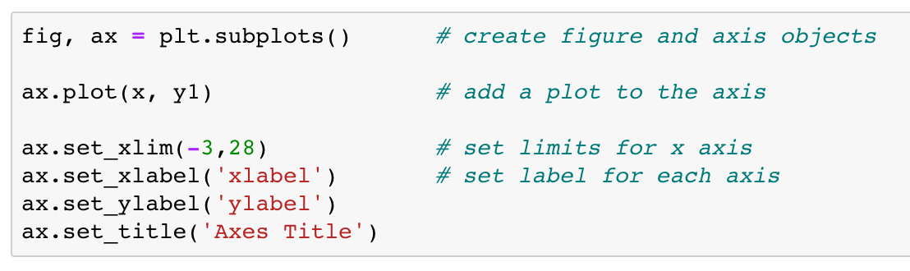
Recap: fancy plotting
Plotting2.ipynb guides you through a number of advanced plotting routines
We will use the "object-oriented" (OO) plotting interface. In this interface, one explicitly creates Python objects for each element of a plot and manipulates these objects to make changes in the plot. This gives one finer control over the look and behavior of the plot

Slide 7
Recap: file I/O
In Python, "everything is an object", and so there is a file object. We create one when we "open" a file.
This means that the file is located, and a counter is set by the operating system to the beginnig of the file. When you read from or write to the file, this counter is adjusted so that subsequent operations occur where you would expect, at the end of where you last wrote or read.
The syntax of the open function is open('filename string’,'X’) where `X` is
`r` if you intend to read from the file
`w` if you wish to start writing to a new file (WARNING: if the file exists, it will be overwritten!)
`a` if you wish to append to an existing file
file = open(”filename.txt", "r") creates the file object, which we then use to operate on the file content

Slide 8
Example: Model fitting
Goal: find model parameters that best fit a data set
find amount of matter and dark energy in the Universe that best describes supernovae data
Step 1 – DATA: what’s your data, and what are they measuring?
measurements of redshift (of the supernovae) and distance (to the supernovae) , i.e., they measure the expansion history of the Universe.
Step 2 – MODEL: a model for the (physical) process the generates your data, cast in the same form/observables as your data
astropy.cosmology module (physics of expanding Universes), which provides functions that model distance as function of redshift
Step 3 – GOODNESS-OF-FIT: compare model and data using the χ² statistic, which quantifies the deviation of model and data, weighted by error of the data
Step 3 – BEST-FIT MODEL: find the set of model parameters that minimize χ², i.e. the model that best fits the data

Slide 9
Week 2: Python Syntax
Arrays, Plotting, File I/O,Example: SN cosmology
Recording from 11/16
Recording from 11/18
Recording from 11/20

Slide 10
RECAP: Lists in Python
a list in python is an ordered collection of objects of any type.
objects in square brackets, e.g. testlist = [1, “a string”, 3.0, “last”]
You can make list of lists, e.g. lol = [[1, 2, 3], [4, 5, 6]]
To access elements of a list, you put the list element (starting with 0) in square brackets
somelist[1] for second element
can access without list name: [4, 5, 6][2]
can access within nested lists: lol[1] givels [4, 5, 6] (i.e. 2nd element)
lol[1][0] gives 4, i.e. first element of 2nd element
add single elements with “dot append” function: a.append(2)
last week’s Problem Set introduced list slicing

Slide 11
Python Syntax: Arrays
Arrays and lists are both container objects used in Python to store data. They both can be used to store any data type (real numbers, strings, etc.), and they both can be indexed and iterated through, but the similarities between the two don't go much further.
For example, you can divide an array by 3, and each number in the array will be divided by 3. If you try to divide a list by 3, Python will tell you that it can't be done, and an error will be thrown.
For practically all calculations, we will use NumPy arrays
Note: arrays need to be declared before you can use them
e.g.: a = np.array([0,1,2,3,4]), b=np.arange(5), c=np.zeros(5) declare one-dimensional arrays
while NumPy has functions that append elements to an array, this does not happen in place; numpy.append(a,b) creates a new array with length(a)+length(b)

Slide 12
Python Syntax: Arrays
Arrays can be multi-dimensional
A = np.zeros ((5,3)) creates a two-dimensional array
B = np.zeros((5,3,2)) creates a three-dimensional array
Arrays can be sliced like lists
a[2:4] accesses elements 3 and 4 of a
A[2:4,1:2] accesses elements [3,2], [4,2], [3,3], and [4,3]
B[2:4,1:2,:] accesses elements [3,2,1], [4,2,1], [3,3,1], [4,3,1], [3,2,2], [4,2,2], [3,3,2], [4,3,2]
Each array has attributes ndim (the number of dimensions), shape (the size of each dimension), and size (the total size of the array)
print(”B ndim: ", B.ndim) 3
print(”B shape:", B.shape) (5,3,2)
print(”B size: ", B.size) 30

Slide 13
Python Syntax: import
The Python programming language comes with a number of basic built-in functions, such as print().
These built-in functions, however, are limited, and we can make use of modules to make more sophisticated programs.
Modules are Python .py files that consist of Python code. Any Python file can be referenced as a module. Modules can define functions, classes, and variables that you can reference in other Python .py files, notebooks, or via the Python command line interpreter.
In Python, modules are accessed by using the import statement. When you do this, you execute the code of the module, keeping the scopes of the definitions so that your current file(s) can make use of these.
import numpy as np loads and executes the NumPy library, and make its functions accessible, e.g. np.sqrt

Slide 14
Python Syntax: plotting
A common (and extensive) python library for plotting is called matplotlib.
matplotlib contains a plotting module pyplot
import matplotlib.pyplot as plt gives you access to all of pyplot's functions, which can be called as plt.functionname
In today’s ProblemSet, we will get to know a function from pyplot called plot, which you can call as: plt.plot(arg1,arg2)

Slide 15
Python Syntax: string formatting
• You already encountered f-strings in Week 1
• print (f”The value of x is {x}”)
• some of the most common formatting options are
• `s` for string
• `d` for decimal (integer) • `f` for float • `e` for exponential (scientific notation)
• Today you will practice formatting the output, specifying type and width
• print(f”{x:<7d} {x:<8.3f} {x:11.3e} {str(x):>30s}”)
• 8.3f -> width of 8 total characters, 3 decimal places • <,>: justify output left/right
• We will also split strings, based on a character in the string, using the split method

Slide 16
Python syntax: fancy plotting
Plotting2.ipynb guides you through a number of advanced plotting routines
We will use the "object-oriented" (OO) plotting interface. In this interface, one explicitly creates Python objects for each element of a plot and manipulates these objects to make changes in the plot. This gives one finer control over the look and behavior of the plot

Slide 17
Python synatx: fancy plotting
Plotting2.ipynb guides you through a number of advanced plotting routines
Manipulating axes objects: axis labels + spines, twin axes, multiple subplots
Plot objects: markers, line styles, error bars, text objects, aspect ratio
Advanced plot styles: histograms, contour plots, color maps + color bars
Saving plots to a file
Customize figure layout of different subplots: https://matplotlib.org/tutorials/intermediate/gridspec.html

Slide 18
Python Syntax : file I/O
In Python, "everything is an object", and so there is a file object. We create one when we "open" a file.
This means that the file is located, and a counter is set by the operating system to the beginnig of the file. When you read from or write to the file, this counter is adjusted so that subsequent operations occur where you would expect, at the end of where you last wrote or read.
The syntax of the open function is open('filename string’,'X’) where `X` is
`r` if you intend to read from the file
`w` if you wish to start writing to a new file (WARNING: if the file exists, it will be overwritten!)
`a` if you wish to append to an existing file
file = open(”filename.txt", "r") creates the file object, which we then use to operate on the file content

Slide 19
Example: formatting strings from a file
We split strings using the split method, and remove characters using the strip method
with open('SCPUnion2.1_mu_vs_z1.txt','r') as infile:
for line in infile:
if line[0]!='#':
line = line.rstrip("\n")
name, z0, dm0, dme0, foo = line.split()

Slide 20
Example: Model fitting
Goal: find model parameters that best fit a data set
find amount of matter and dark energy in the Universe that best describes supernovae data
Step 1 – DATA: what’s your data, and what are they measuring?
measurements of redshift (of the supernovae) and distance (to the supernovae) , i.e., they measure the expansion history of the Universe.
Step 2 – MODEL: a model for the (physical) process the generates your data, cast in the same form/observables as your data
astropy.cosmology module (physics of expanding Universes), which provides functions that model distance as function of redshift
Step 3 – GOODNESS-OF-FIT: compare model and data using the χ² statistic, which quantifies the deviation of model and data, weighted by error of the data
Step 3 – BEST-FIT MODEL: find the set of model parameters that minimize χ², i.e. the model that best fits the data

Slide 21
Week 1: Python Syntax
Variables, Booleans, Conditionals, Loops, Functions
Recording from 11/09
Recording from 11/11
Recording from 11/13

Slide 22
Memory, variables, and expressions
Computer memory: ~enormous list of binary digits.
need to know the location of any given datum and its contents
Low-level: refer to every location in memory by its numerical address (“add the number stored at location 8283747723 to the number stored at 4239128797 and put the result in location 7512398794”)
high-level programming languags simplify the bookkeeping by providing a mnemonic name for a location in memory: a variable.
When we say in Python var = 4, python chooses an unused location in memory and associates it with the text var – much easier for us to remember.
var then refers to the contents of that location, wherever it may be.

Slide 23
Memory, variables, and expressions
A program is a set of instructions for the computer to take some action.
If we write dummy = var, this is not the mathematical statement that dummy is equal to var. Instead, the statement will be translated by the compiler into instructions for the CPU which say, roughly:
1. Take the datum stored in the location in memory associated with var and stick it in a temporary location within the CPU (known as a register).
2. Take the contents of that register, and store it in the location in memory associated with dummy.
The symbol = in the above statement is an operator;
specifically, it is the assignment operator, assigning the value appearing to its right to the variable appearing on its left. The expression to the right can be more complex. We can for example write x = var + 24.
What might this statement be to the computer?
dummy

Slide 24
Conditional Statements
Boolean Operators can be used to build more interesting expressions
A conditional statement executes if a given boolean statement is true. The general syntax is
if BOOLEAN_EXPRESSION:
STATEMENT
We’ll learn how to use this during part one of today’s tutorial.

Slide 25
Loops
a loop is a sequence of instructions that is continually repeated until a condition is reached
Today, we’ll cover two types of loops:
While Loops repeat as long as a certain boolean condition is still true.
The general syntax is :
while BOOLEAN_EXPRESSION:
STATEMENT
For Loops iterate a given number of times.
The general syntax is:
for RANGE:
STATEMENT

Slide 26
Functions
A function is a block of code which only runs when it is called. You can pass data, known as parameters, into a function. A function can return data as a result.
This is a convenient way to write code that can be reused without copying.
In python, functions are defined using the block keyword "def", followed with the function's name as the block's name. The instructions within the function block are indented.
def my_function (<parameters>):
STATEMENT
return <result>

Slide 27
Recursion
Recursion is a method of programming or coding a problem, in which a function calls itself one or more times in its body. Usually, it is returning the return value of this function call. A recursive function includes an escape clause, to avoid infinite loops.
Example: Factorial function (!): n! = 1*2*…*(n-1)*n
def factorial(n):
if n <= 1:
return 1 #escape clause
else:
return n * factorial(n-1) #recursive call

Slide 28
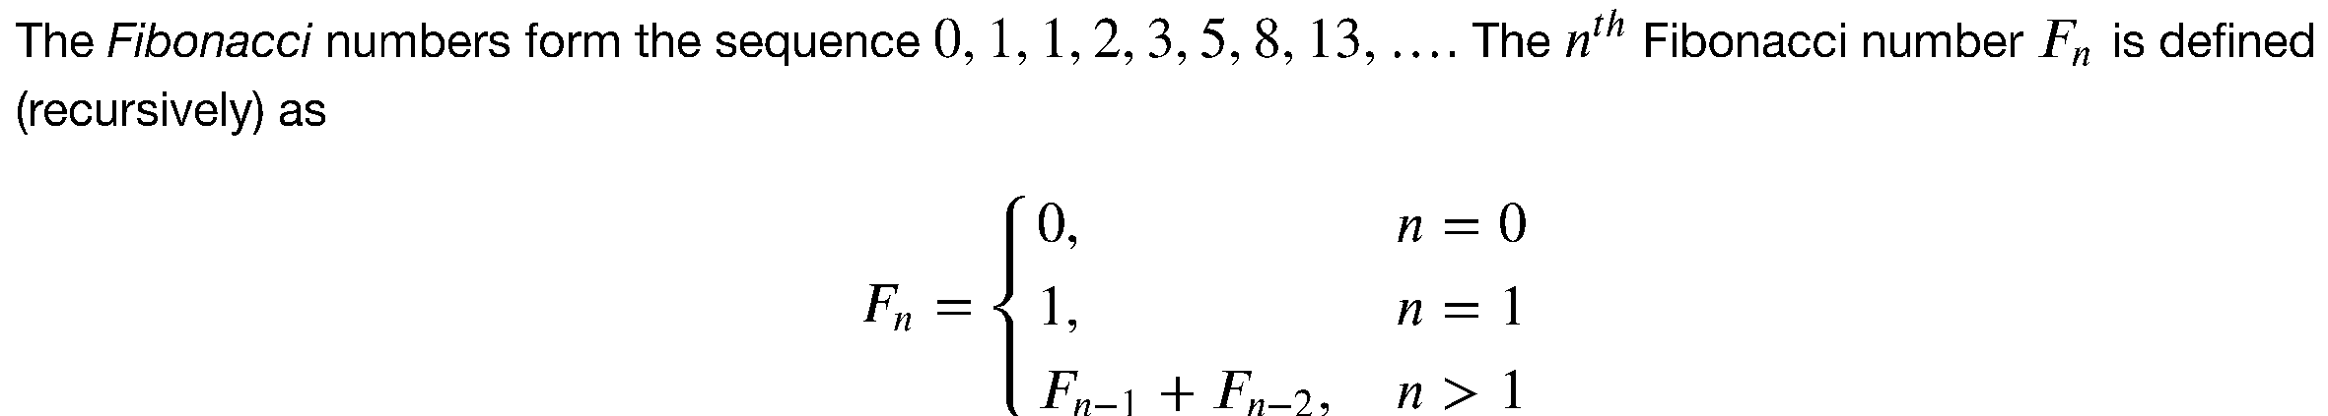
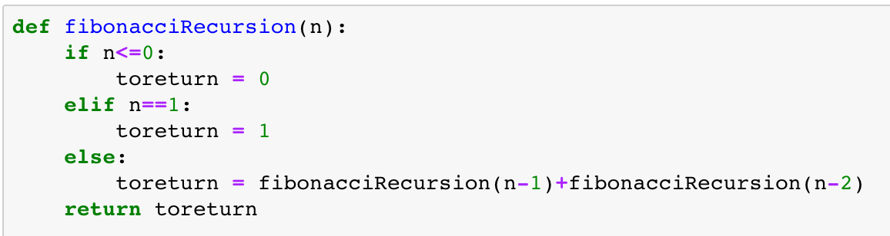
RECAP: computing Fibonacci numbers

Slide 29

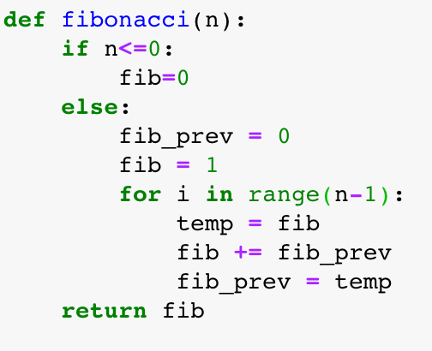
RECAP: computing Fibonacci numbers
To calculate F_{n} iteratively, we use a loop that calculates F_{i} from F_{i-1} and F_{i-2} for all i < n.
To see how this works, write out the steps for n = 3:
fib_prev = 0 = F₀
fib = 1 = F₁
for i in range(n-1): # i takes on the values 0,1
i = 0:
temp = fib = F₁
fib = fib + fib_prev = F₁+F₀= F₂
fib_prev = temp = F₁
i = 1:
temp = fib = F₂
fib = fib + fib_prev = F₂+F₁= F₃
fib_prev = temp = F₂
return fib = F₃

Slide 30
Lists in Python
a list in python is an ordered collection of objects of any type.
objects in square brackets, e.g. testlist = [1, “a string”, 3.0, “last”]
You can make list of lists, e.g. lol = [[1, 2, 3], [4, 5, 6]]
To access elements of a list, you put the list element (starting with 0) in square brackets
somelist[1] for second element
can access without list name: [4, 5, 6][2]
can access within nested lists: lol[1] givels [4, 5, 6] (i.e. 2nd element)
lol[1][0] gives 4, i.e. first element of 2nd element
empty lists are a good starting point a = []
add single elements with “dot append” function: a.append(2)

Slide 31
List Slicing
Access elements of lists (and other containers) with slicing:
ll[n:m] gives elements n+1 to m
ll[:n] gives first n elements
ll[n:] gives elements n+1 to the end
Stride or stepsize given by a third entry after a 2nd colon
ll[::n] step size n, try ll[::3]
ll[::-1] elements in reverse order
ll[::-n] elements in reverse order with stepwise n
can combine stride and slicing, e.g.
ll[10:15:2]
ll[15:10:-2] because stepping backwards
ll[10:15][::-2] it takes practice to understand difference!

Slide 32
List Slicing (part2)
List elements and slicing with negative integers
We already saw that negative integers for the stepsize (the third entry) means that elements are extracted in reverse order.
Similarly, negative integers for the start or stop index (either of the first two entries) count backwards from the end. Thus:
ll[-1] gives the last element of the list
ll[-n] gives the n-th last element, i.e. -2 the second to last
ll[-n:] gives the last n elements
ll[n:-m] gives from element n+1 to the element m-th last element, e.g.
ll[0:-1] is just another way to give the whole list (from first to last elements)

Slide 33
Python Tutorial Planning

Slide 34
Goals for this course
Introduction to python for scientific computing
Support your python programming progress: hands-on practice and discussion sessions
This is not a mandatory course, and there are no grades. I’ll post the topics for each week, and invite you to join the sessions that are most useful to you!
Why choose to learn python? high-level programming language, (relatively) simple to learn, freely available packages for wide range of science applications

Slide 35
A bit about myself
I’m a cosmologist, connecting theory and data analysis. Of my research time,
~5% are paper-and-pencil cosmology work
~15% are thinking about statistics and algorithms
~60% are programming/debugging/documentation
~20% are discussion/interpretation/writing
I work in several large survey collaborations - groups of hundreds of scientists worldwide working together to analyze these large data sets.
I’m currently an assistant professor in physics and astronomy at the University of Arizona, where I teach computational physics at different levels.

Slide 36
Installing Python
INSTALLING THE ANACONDA PYTHON DISTRIBUTION
• for Windows: https://docs.anaconda.com/anaconda/install/windows/
• for OsX: https://docs.anaconda.com/anaconda/install/mac-os/
• for LINUX: https://docs.anaconda.com/anaconda/install/linux/
for android: pydroid3
You will first be asked to review the license agreement. Hit ``enter'' and page down with the space bar until you are asked to approve. Type ``yes''
and hit ``enter’'. Next you will be asked for a location into which to install the distribution. I use .anaconda3 instead of the default, since this is a hidden file and I am less likely to erase it!
All of the Python packages we will be using will be installed into your account under the directory you specified. This will take quite some time to complete. When you are asked ``Do you wish the installer to initialize Anaconda3 by running conda init?'', answer ``yes''.
Next update the installation to the latest version by typing
> conda update conda
Answer ``y'' when asked if you wish to update, and wait for the update to finish. You now have a working Python distribution installed!

Slide 37
Getting started
Complete python installation (see email for instructions)
Download the notebook Python (1).ipynb from google drive, save it in a folder
Start a notebook session: https://jupyter-notebook-beginner-guide.readthedocs.io/en/latest/execute.html
Now open Python (1).ipynb and follow along

